Slide 1
Data Ingestion
Emanuele Della Valle
Prof. @ Politecnico di Milano & Partner @ Quantia Consulting
Marco Balduini
Founder & CEO @ Quantia Consulting

Slide 2
Introduction Data Ingestion

Slide 3
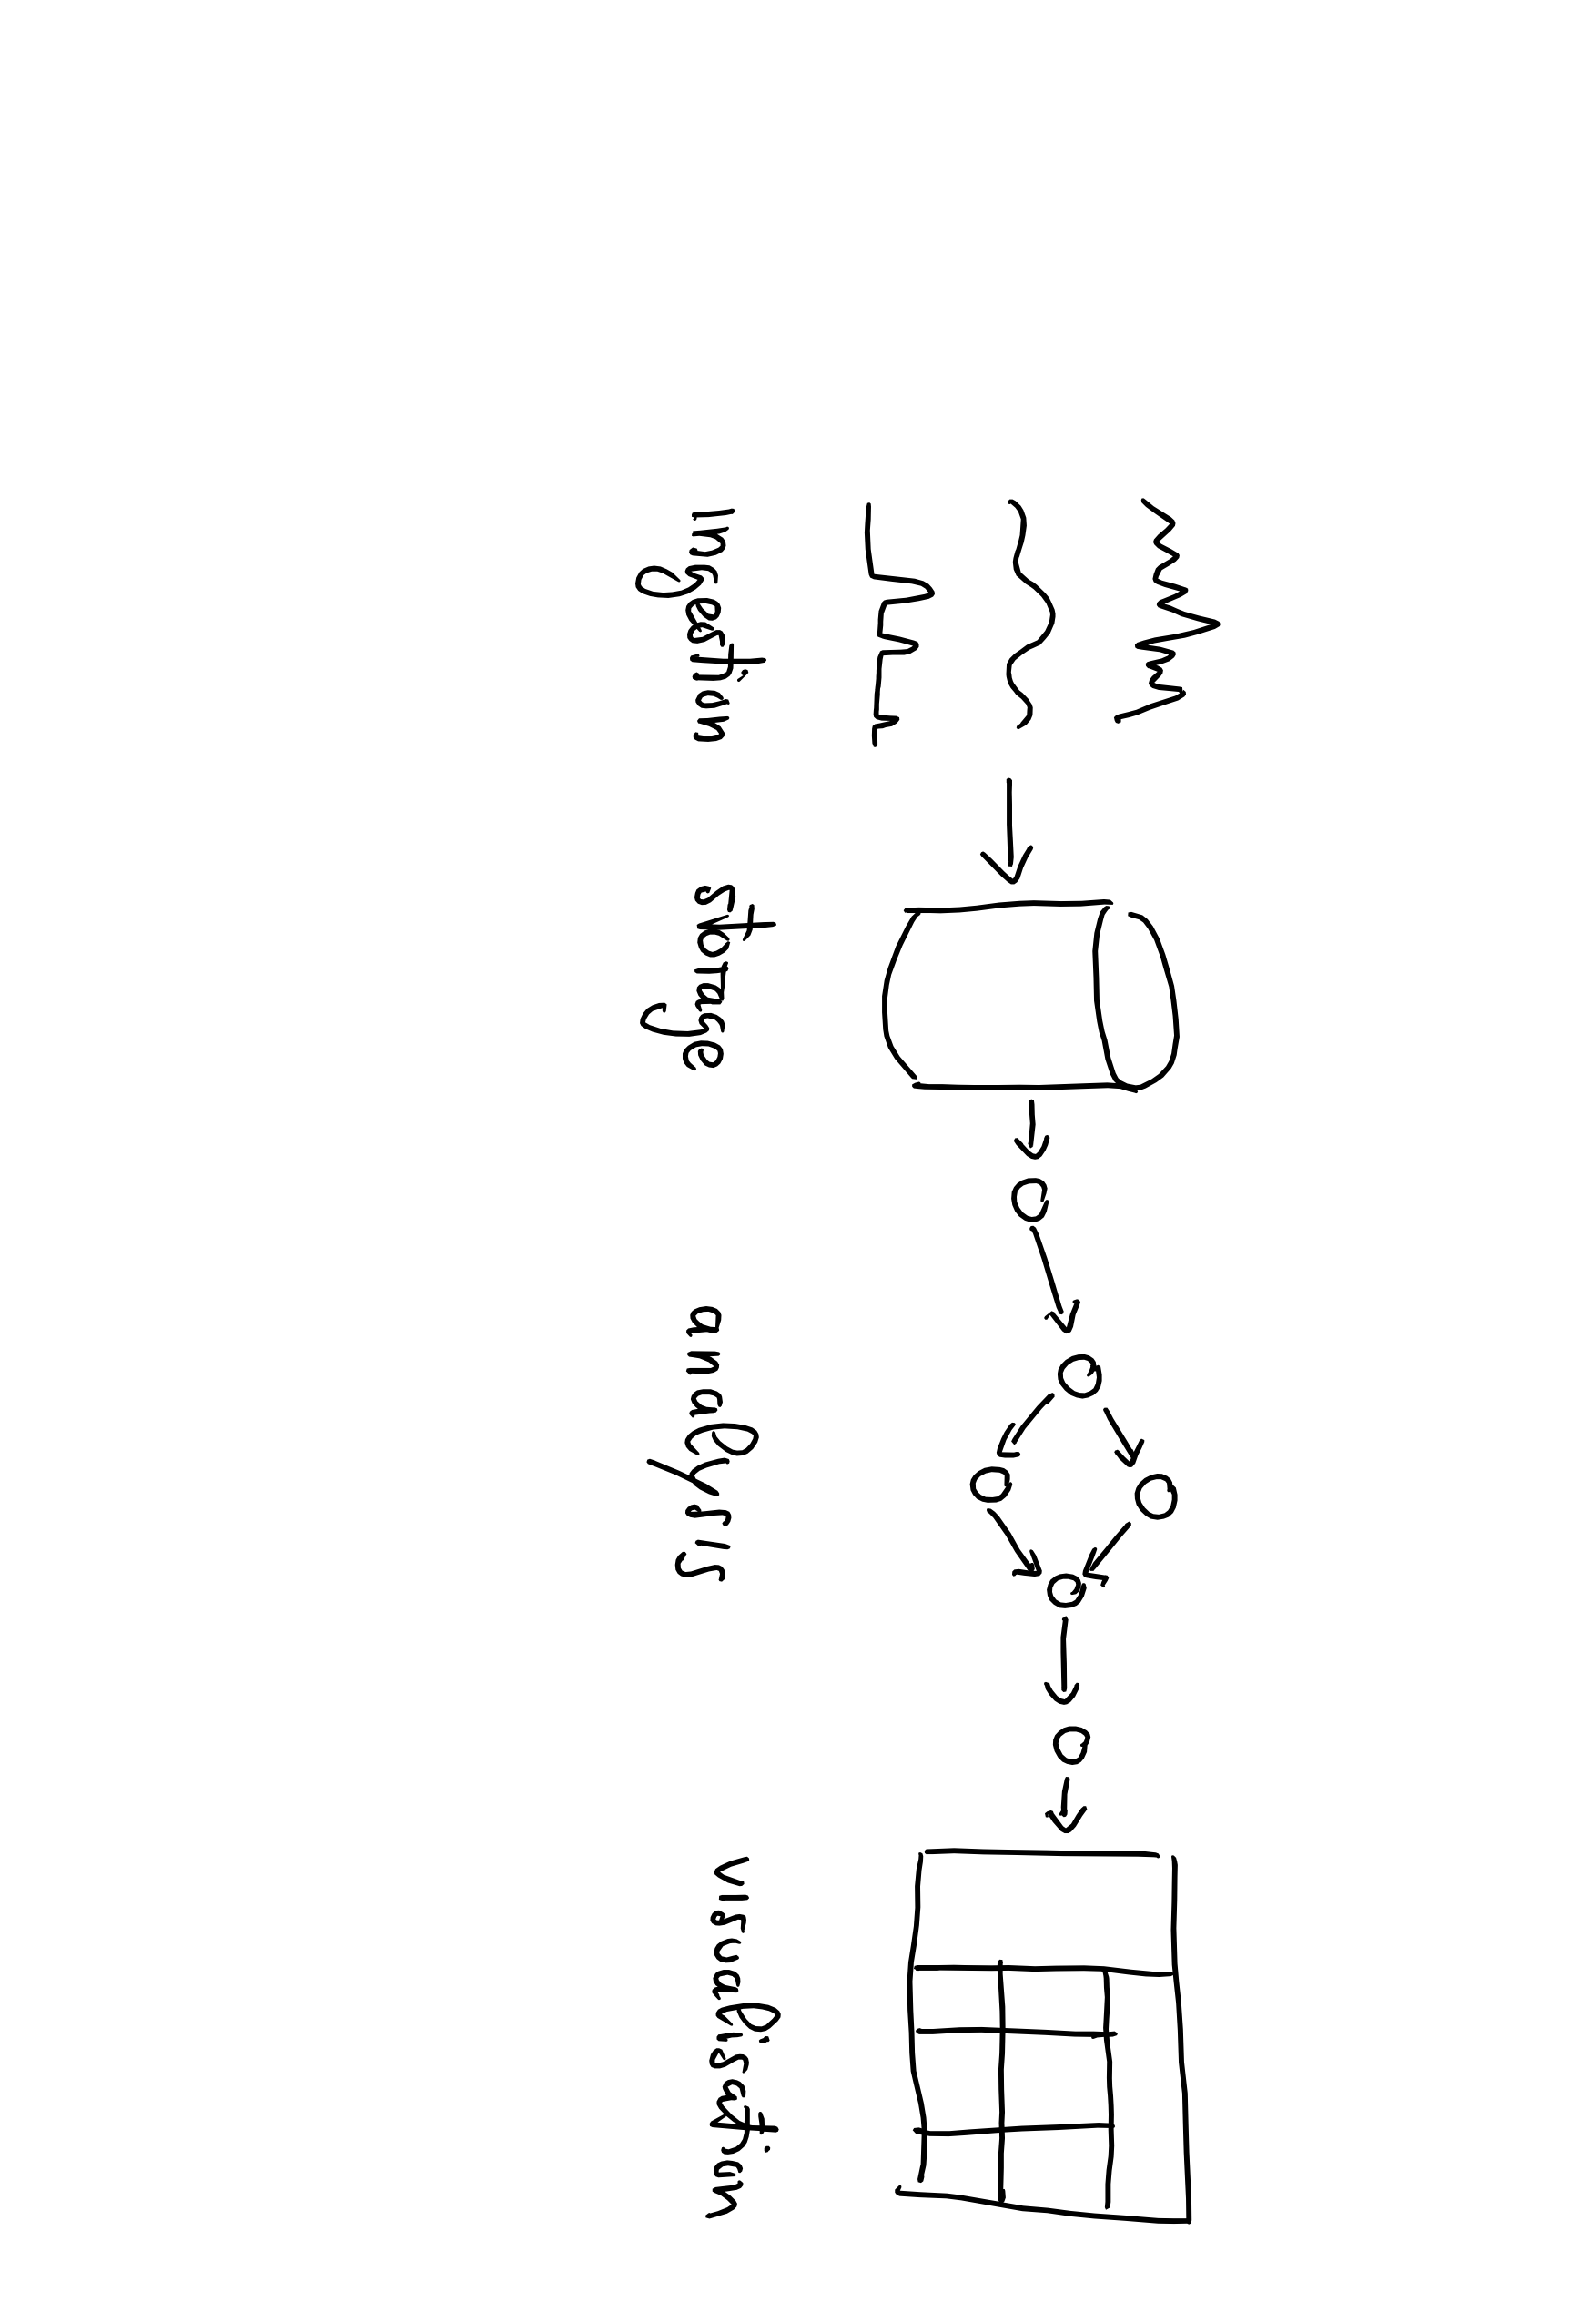
Data Lifecycle

Slide 4
Data Lifecycle

Slide 5
Data Lifecycle

Slide 6
How is data ingested? Data Ingestion

Slide 7
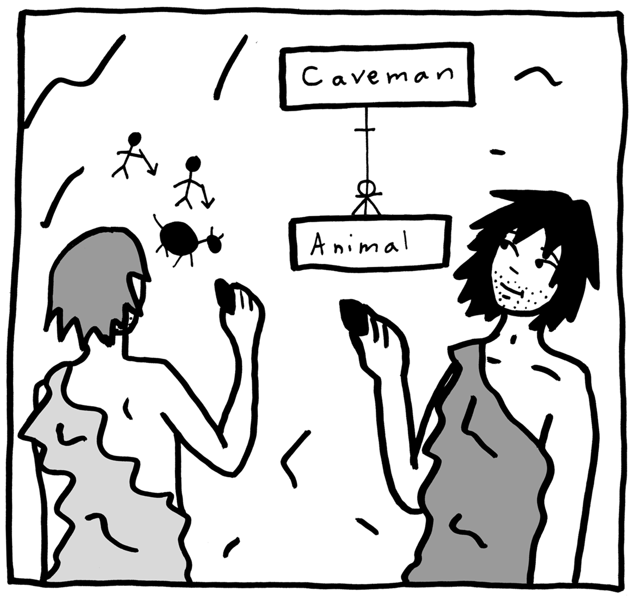
Conceptual vs. logical vs. physical views
[Src: https://www.oreilly.com/library/view/data-modeling-made/9781935504481/ ]

Slide 8
How is data ingested? Conceptual View

Slide 9
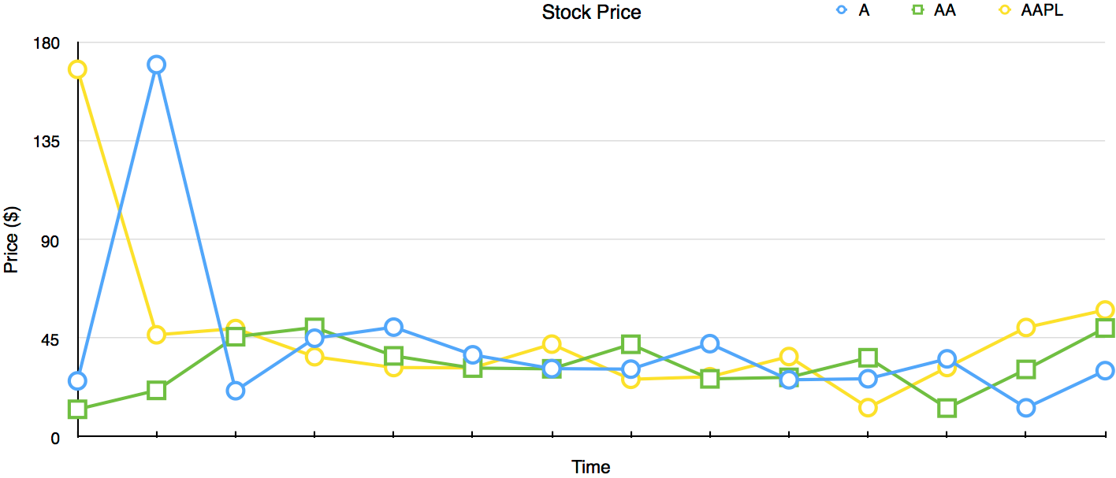
Let’s start from the anatomy of a Time-Series Line Graph

Slide 10
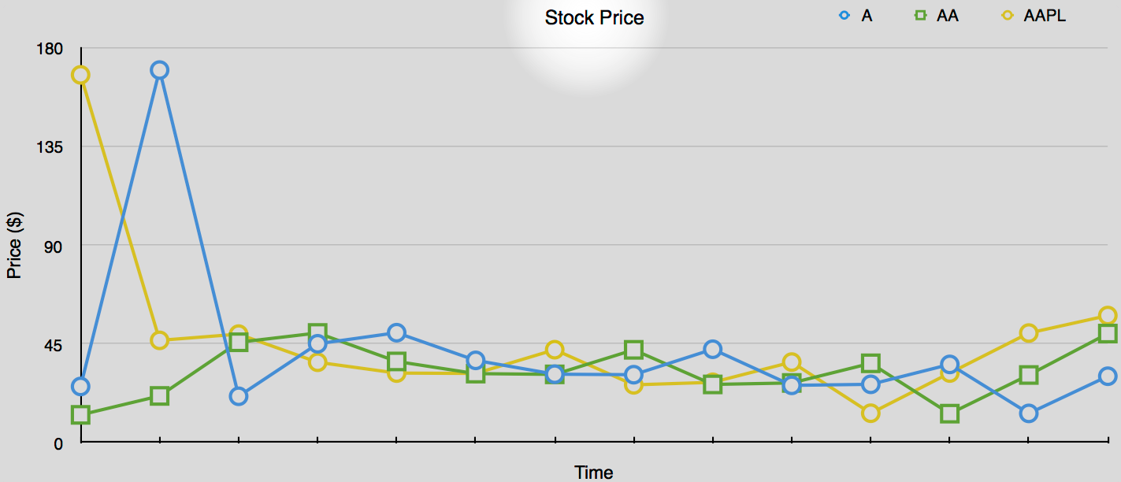
The type of measurement is the title of the Line Graph

Slide 11
Data Model
Measurement
The name of the measurement used as high level grouping of data
Tag set
Other lower level grouping criteria of data
Fields
Actual data
Timestamp
Time of the data
Series
A unique combination of measurement+tags

Slide 12
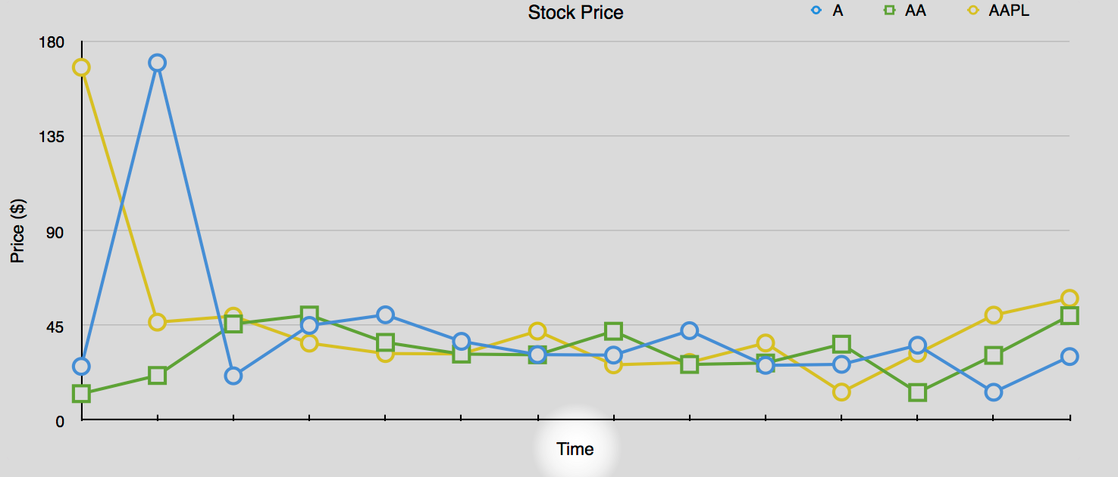
Time stamps are on the X-Axis

Slide 13
Data Model
Measurement
The name of the measurement used as high level grouping of data
Tag set
Other lower level grouping criteria of data
Fields
Actual data
Timestamp
Time of the data
Series
A unique combination of measurement+tags

Slide 14
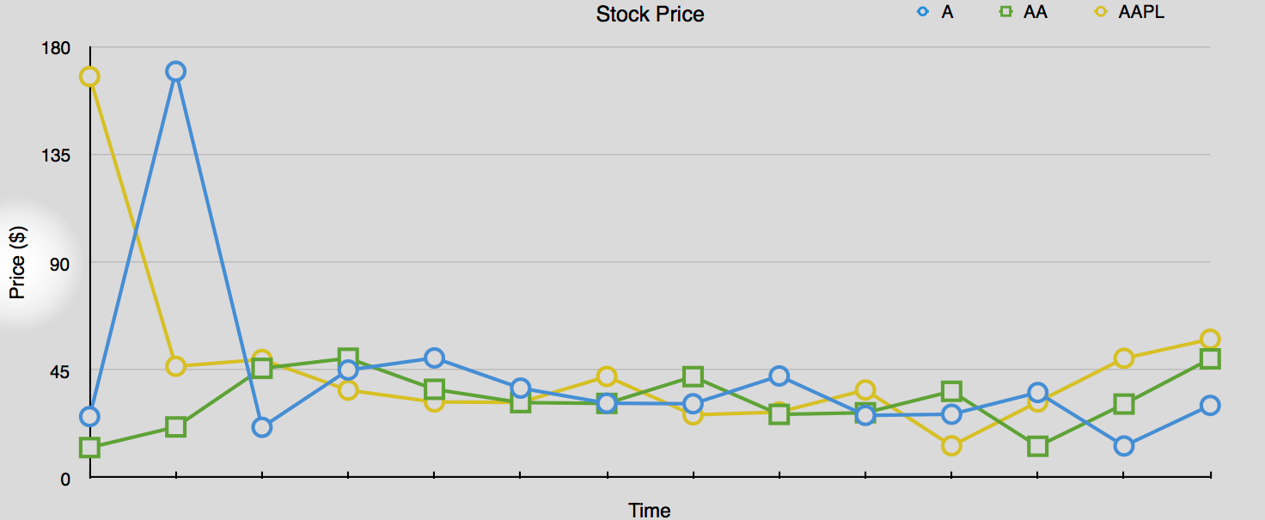
Data is on the Y-Axis

Slide 15
Data Model
Measurement
The name of the measurement used as high level grouping of data
Tag set
Other lower level grouping criteria of data
Field set
Actual data
Timestamp
Time of the data
Series
A unique combination of measurement+tags

Slide 16
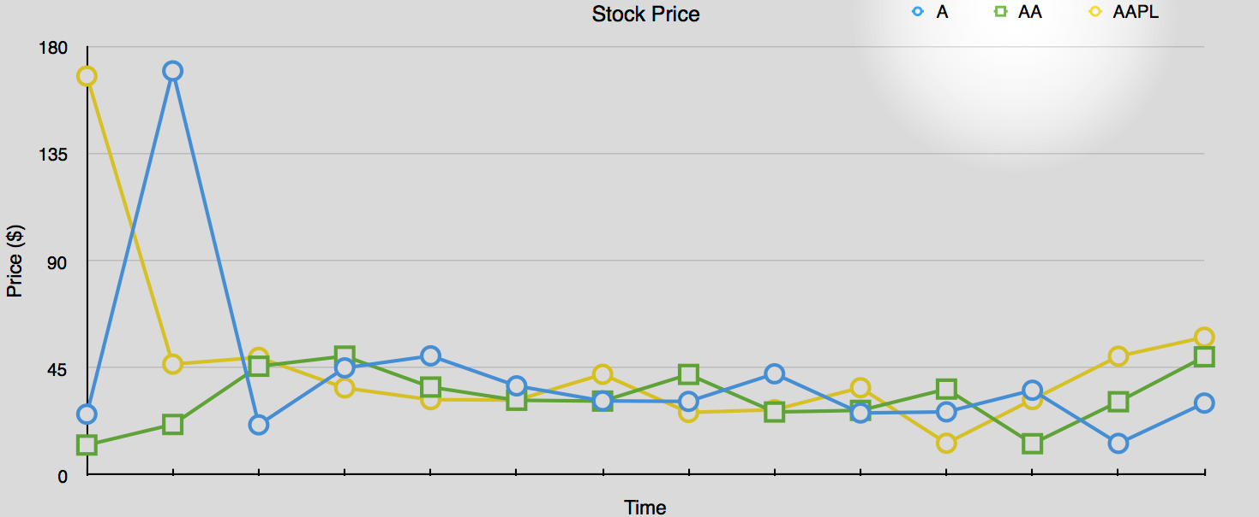
The Legend distinguishes the three time series in the graph

Slide 17
Data Model
Measurement
The name of the measurement used as high level grouping of data
Tag set
Other lower level grouping criteria of data
Field set
Actual data
Timestamp
Time of the data
Series
A unique combination of measurement+tags

Slide 18
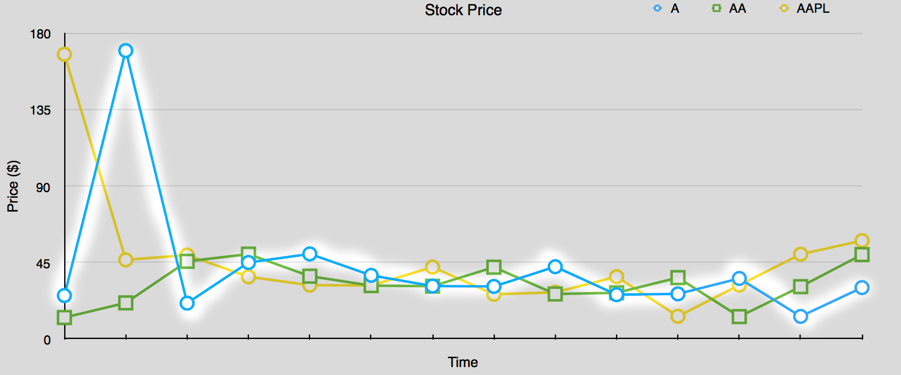
A series in the graph thus is …

Slide 19
Data Model
Measurement
The name of the measurement used as high level grouping of data
Tag set
Other lower level grouping criteria of data
Field set
Actual data
Timestamp
Time of the data
Series
Data points in time order grouped by measurements and tags

Slide 20
How is data ingested? Logical View

Slide 21
Data Model
Measurement
A name to group data at high level
Tag set
A set of key-value pairs to group data at low level
Field set
A set of key-value pairs to represent data
Timestamp
Time of the data with nanosecond precision
Series
A unique combination of measurement+tags

Slide 22
Data model vs ingestion & storage
Series
Buckets
(set of series)
Measurement
Tag set
Field set
Timestamp

Slide 23
How is data ingested? Physical View

Slide 24
Line protocol
measurement,tags fields timestamp
tags (a.k.a. tag set):
syntax: key-value pair separated by a comma “,”
e.g. ticker=A
Fields (a.k.a field set):
syntax: key-value pair, separated by a comma “,”
e.g. price=42
timestamp:
up to nanosecond-precision Unix time
Reference: https://v2.docs.influxdata.com/v2.0/reference/line-protocol/
whitespace I
whitespace II

Slide 25
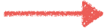
An example of Line Protocol
cpu,host=serverA,num=1,region=west idle=1.667,system=2342.2 1492214400000000000
Measurement

Slide 26
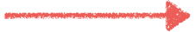
An example of Line Protocol
cpu,host=serverA,num=1,region=west idle=1.667,system=2342.2 1492214400000000000
Tags

Slide 27
An example of Line Protocol
cpu,host=serverA,num=1,region=west idle=1.667,system=2342.2 1492214400000000000
Fields

Slide 28
An example of Line Protocol
cpu,host=serverA,num=1,region=west idle=1.667,system=2342.2 1492214400000000000
timestamp

Slide 29
Bucket physical view
Columnar Data Stores
Best for column selection and aggregation thanks to
Disk + Memory locality
Cache locality
_time
host
num
region
idle
system
1492…0
serverA
1
west
1.667
2342.2
1492…1
serverB
1
west
1789.4
2.779
…
…
…
…
…
…
tags
fields

Slide 30

Let’s get dirty!
0

Slide 31
What’s the line protocol representation of this point?
stock_price,ticker=A price=170 1465839830100400200
NOTE: The nanosecond-precision Unix time for the value is 1465839830100400200

Slide 32
Let’s get more dirty!
1

Slide 33
Use Case: Continuous Linear Pizza Oven
Sensors observe
temperature (C°)
relative humidity (%)
of the two ovens
Learning Goals
Basic line protocol usage
s2
s1

Slide 34
Task
Model the following data representing the temperatures, from both sensors, over time
measurement | sensor | value | ts
temperature | S1 | 290 | 1569888000000000000
temperature | S2 | 105 | 1569888015000000000
temperature | S1 | 305 | 1569888060000000000
temperature | S2 | 120 | 1569888075000000000

Slide 35
Let’s continue on gitter
https://gitter.im/quantia-cons/flux-training-sf-2019#

Slide 36
Let’s get even more dirty!
2

Slide 37
Use Case: Continuous Linear Pizza Oven
Sensors observe
temperature (C°)
relative humidity (%)
of the two ovens
Learning Goals
Advanced line protocol usage
s2
s1

Slide 38
Task
Model the following data representing the temperatures and the humidities, from both sensors, over time.
measurement | sensor | temperature | humidity | ts
iot-oven | S1 | 290 | 30 | 1569888000000000000
iot-oven | S2 | 105 | 55 | 1569888015000000000
iot-oven | S1 | 305 | 38 | 1569888060000000000
iot-oven | S2 | 120 | 65 | 1569888075000000000

Slide 39
How is data automatically ingested? Physical View

Slide 40
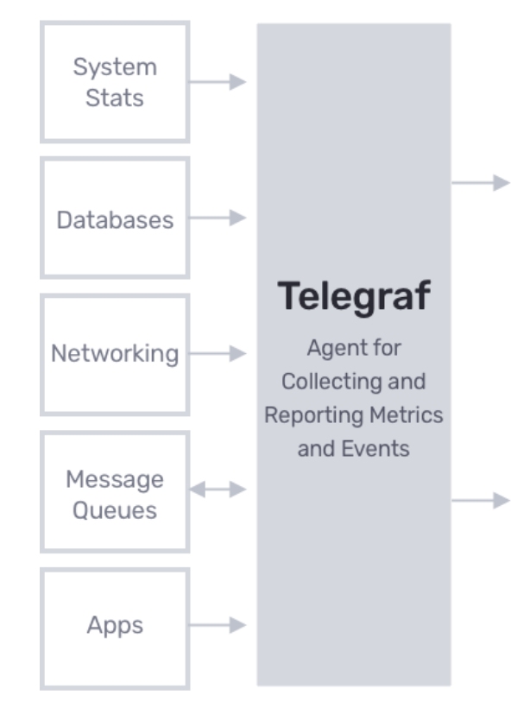
Telegraf
Telegraf is a data collection agent
It is based on a Plug and Play architecture
It offers a variety of input plugins
It can be configured from the influxDB cloud UI
Download and install: https://docs.influxdata.com/telegraf/v1.12/introduction/installation/

Slide 41
Positioning Telegraf in the ingestion pipeline
Telegraf

